Slide 1
Object-Oriented Programming: Abstract Classes and Polymorphism

Slide 2
Abstract Classes and Methods
Abstract classes
Are superclasses (called abstract superclasses)
Cannot be instantiated
Incomplete
subclasses fill in "missing pieces"
Concrete classes
Can be instantiated
Implement every method they declare
Provide specifics

Slide 3
Abstract Classes and Methods
Purpose of an abstract class
Declare common attributes …
Declare common behaviors of classes in a class hierarchy
Contains one or more abstract methods
Subclasses must override
Instance variables, concrete methods of abstract class
subject to normal rules of inheritance

Slide 4
Abstract Classes
Classes that are too general to create real objects
Used only as abstract superclasses for concrete subclasses and to declare reference variables
Many inheritance hierarchies have abstract superclasses occupying the top few levels

Slide 5
Keyword abstract
Use to declare a class abstract
Also use to declare a method abstract
Abstract classes normally contain one or more abstract methods
All concrete subclasses must override all inherited abstract methods

Slide 6
Beware! Compile Time Errors
Attempting to instantiate an object of an abstract class
Failure to implement a superclass’s abstract methods in a subclass
unless the subclass is also declared abstract.

Slide 7
Creating Abstract Superclass Employee
abstract superclass Employee,
earnings is declared abstract
No implementation can be given for earnings in the Employee abstract class
An array of Employee variables will store references to subclass objects
earnings method calls from these variables will call the appropriate version of the earnings method

Slide 8
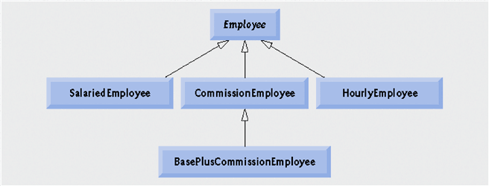
Example Based on Employee
Abstract Class
Concrete Classes

Slide 9
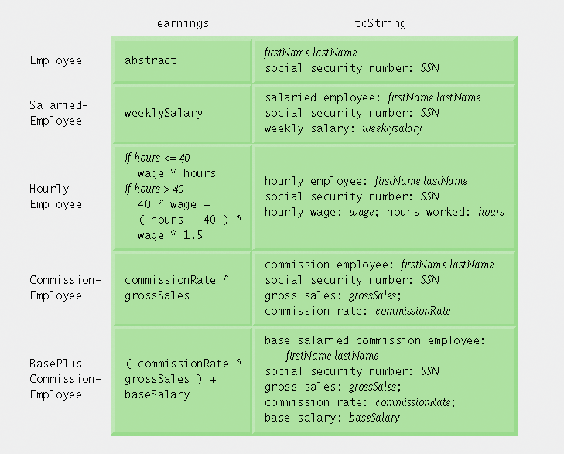
Polymorphic interface for the Employee hierarchy classes.

Slide 10
Introduction
Polymorphism
Enables “programming in the general”
The same invocation can produce “many forms” of results
Interfaces
Implemented by classes to assign common functionality to possibly unrelated classes

Slide 11
Polymorphism
When a program invokes a method through a superclass variable,
the correct subclass version of the method is called,
based on the type of the reference stored in the superclass variable
The same method name and signature can cause different actions to occur,
depending on the type of object on which the method is invoked

Slide 12
Polymorphism
Polymorphism enables programmers to deal in generalities and
let the execution-time environment handle the specifics.
Programmers can command objects to behave in manners appropriate to those objects,
without knowing the types of the objects
(as long as the objects belong to the same inheritance hierarchy).

Slide 13
Polymorphism Promotes Extensibility
Software that invokes polymorphic behavior
independent of the object types to which messages are sent.
New object types that can respond to existing method calls can be
incorporated into a system without requiring modification of the base system.
Only client code that instantiates new objects must be modified to accommodate new types.
Notes:
Late Binding:
We often treat an object not as its own type, but as its base type (superclass or interface). This allows you to write codes that do not depends on a specific implementation type. In the Shape example, we can always use getArea() and do not have to worry whether they are triangles or circles.
This, however, poses a new problem. The compiler cannot know at compile time precisely which piece of codes is going to be executed at run-time (e.g., getArea() has different implementation for Rectangle and Triangle).
In the procedural language like C, the compiler generates a call to a specific function name, and the linkage editor resolves this call to the absolute address of the code to be executed at run-time. This mechanism is called static binding (or early binding).
To support polymorphism, object-oriented language uses a different mechanism called dynamic binding (or late-binding or run-time binding). When a method is invoked, the code to be executed is only determined at run-time. During the compilation, the compiler checks whether the method exists and performs type check on the arguments and return type, but does not know which piece of codes to execute at run-time. When a message is sent to an object to invoke a method, the object figures out which piece of codes to execute at run-time.
Although dynamic binding resolves the problem in supporting polymorphism, it poses another new problem. The compiler is unable to check whether the type casting operator is safe. It can only be checked during runtime (which throws a ClassCastException if the type check fails).
JDK 1.5 introduces a new feature called generics to tackle this issue. We shall discuss this problem and generics in details in the later chapter

Slide 14
Demonstrating Polymorphic Behavior
A superclass reference can be aimed at a subclass object
a subclass object “is-a” superclass object
the type of the actual referenced object, not the type of the reference, determines which method is called

Slide 15
Polymorphism
Promotes extensibility
New objects types can respond to existing method calls
Can be incorporated into a system without modifying base system
Only client code that instantiates the new objects must be modified
To accommodate new types

Slide 16
Example Based on Employee
Abstract Class
Concrete Classes

Slide 17
Example
Employee [] employees = new Employee [4];
employees[0] = new CommisionEmployee();
employees[1] = new SalariedEmployee();
employees[2] = new HourlyEmployee();
employees[3] = new BaseCommEmployee();
for ( int i=0; i<=3;i++)
{
System.out.printf(employees[i].earnngs()); employees[i].display()); }
}

Slide 18
Note in Example Hierarchy
Dynamic binding
Also known as late binding
Calls to overridden methods are resolved at execution time, based on the type of object referenced

Slide 19
Downcasting
for ( int i=0; i<4;i++) {
If ( employees[i].getClass().conatins(“BasePlusCommisionEmployee”)
{
BasePlusCommissionEmployee emp=
(BasePlusCommissionEmployee ) employees[i];
emp.setBaseSalary( 1.10 * emp.getBaseSalary() );
S.O.P("new base salary with 10%% increase is emp.getBaseSalary() );
employee[i]=emp;
}
System.out.printf(employees[i].earnngs());
} //end for

Slide 20
Allowed Assignment between super and Sub class
Assigning a super class reference to a super class variable is straightforward.
Assigning a subclass reference to a subclass variable is straightforward.
Assigning a subclass reference to a super class variable is safe, because the subclass object is an object of its super class.

Slide 21
Allowed Assignment between super and Sub class
However, the super class variable can be used to refer only to super class members.
If this code refers to subclass-only members through the super class variable, the compiler reports errors
Downcasting can overcome this error

Slide 22
Superclass And Subclass Assignment Rules
Assigning a superclass reference to superclass variable straightforward
Subclass reference to subclass variable straightforward
Subclass reference to superclass variable safe
because of is-a relationship
Referring to subclass-only members through superclass variables a compilation error
Superclass reference to a subclass variable a compilation error
Downcasting can get around this error

Slide 23
Interface
Suppose that the company involved wishes to perform several accounting operations in a single accounts payable application—in addition to calculating the earnings that must be paid to each employee, the company must also calculate the payment due on each of several invoices (i.e., bills for goods purchased).?

Slide 24
Interfaces
Though applied to unrelated things (i.e., employees and invoices), both operations have to do with obtaining some kind of payment amount.
For an employee, the payment refers to the employee’s earnings.
For an invoice, the payment refers to the total cost of the goods listed on the invoice.

Slide 25
Interface
Can we calculate such different things as the payments due for employees and invoices in a single application polymorphically
Interface offer a capability requiring that unrelated classes implement a set of common methods

Slide 26
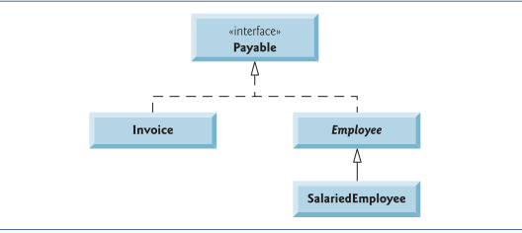
Interfaces

Slide 27
Why Use Interfaces
Provide capability for unrelated classes to implement a set of common methods
Define and standardize ways people and systems can interact
Interface specifies what operations must be permitted
Does not specify how performed

Slide 28
What is an Interface?
An interface is a collection of constants and method declarations
An interface describes a set of methods that can be called on an object
The method declarations do not include an implementation
there is no method body

Slide 29
What is an Interface?
A child class that extends a parent class can also implement an interface to gain some additional behavior
Implementing an interface is a “promise” to include the specified method(s)
A method in an interface cannot be made private

Slide 30
When A Class Definition Implements An Interface:
It must implement each method in the interface
Constants from the interface can be used as if they had been defined in the class (They should not be re-defined in the class)

Slide 31
Declaring Constants with Interfaces
Interfaces can be used to declare constants used in many class declarations
These constants are implicitly public, static and final

Slide 32
Implementation vs. Interface Inheritance
Implementation Inheritance
Each new subclass inherits one or more methods declared in superclass
Subclass uses superclass declarations
Interface Inheritance
Interface specifies one or more abstract methods
Must be declared for each class in hierarchy
Overridden for subclass-specific implementations

Slide 33
Creating and Using Interfaces
Declaration begins with interface keyword
Classes implement an interface (and its methods)
Contains public abstract methods
Classes (that implement the interface) must implement these methods

Slide 34
Why Use Interfaces
Java has single inheritance, only
This means that a child class inherits from only one parent class
Sometimes multiple inheritance would be convenient
Interfaces give Java some of the advantages of multiple inheritance without incurring the disadvantages

Slide 35
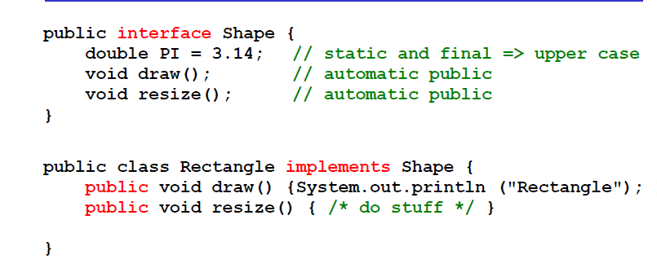
Example

Slide 36
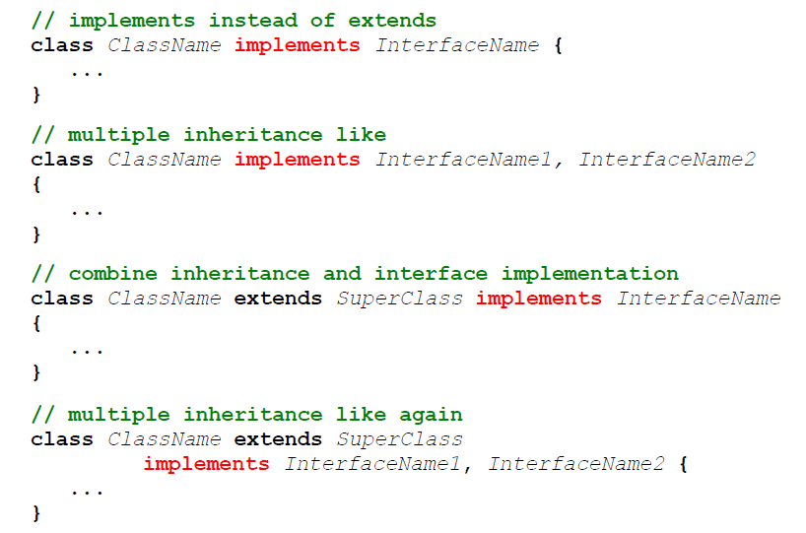
Rules

Slide 37
Some of Java's Most used Interfaces
Cloneable
To make a copy of an existing object via the clone() method on the class Object.
Serializable
Pack a web of objects such that it can be send over a network or stored to disk. And naturally later be restored as a web of objects.

Slide 38
The Cloneable Interface
A class X that implements the Cloneable interface tells clients that X objects can be cloned.
The interface is empty, i.e., has no methods.
Returns an identical copy of an object.

Slide 39
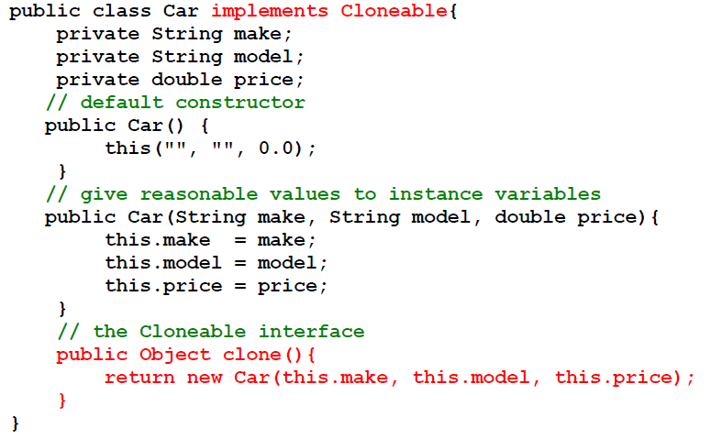
The Cloneable Interface, Example

Slide 40
The Cloneable Interface,
newCarObject = oldCarObject.clone();
Copies newCarObject to a new memory location
newCarObject = oldCarObject;
Only assigns the reference of oldCarObjec to newCarObject .
No copy is made. Both objects point to same memory location.

Slide 41
The Cloneable Interface
As interfaces doesn't contain implementation (this is changed from Java 8 onwards), it is placed in Object class (root) and made Cloneable as marker interface (without any methods).
This makes the class which is Cloneable to just implement Cloneable interface without providing implementation for clone() method.

Slide 42
The Cloneable Interface
One more thing to note is that clone() method in Object class has access modifier protected, this is to restrict call to this method from outside by default.
The class which is Cloneable can change the access modifier to public to allow access to outside.

Slide 43
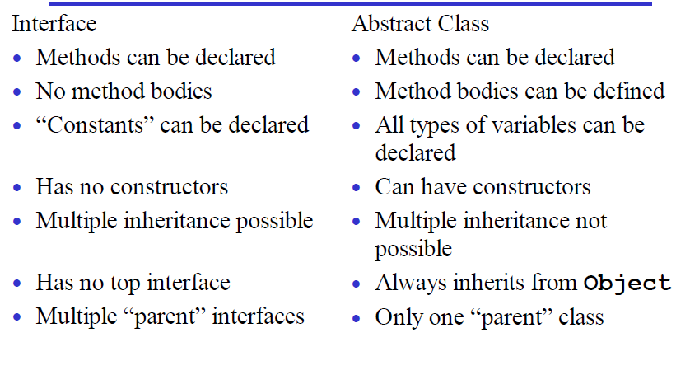
Summary ( Abstract vs Interface)

Slide 44
Design guidelines
Use classes for specialization and generalization
Use interfaces to add properties to classes.

Slide 45
End

